Slide 1
Introduction To IEEE Power and Energy Society

Slide 2
Mission Of PEs
To be the leading provider of scientific and engineering information on electric power and energy for the betterment of society, and the preferred professional development source for our members.

Slide 3
IEEE PES at a Glance
Established in 1884
40,000 members worldwide
250+ local chapters across 10 global regions
Eight peer-reviewed technical publications
20 technical committees
400+ related standards
40+ conferences per year, plus hundreds of local meetings

Slide 4
Committees of the Technical Council
Analytic Methods for Power Systems
Electric Machinery
Energy Development and Power Generation
Energy storage & Stationary Battery
Nuclear Power Engineering
Power Systems Communications and Cybersecurity

Slide 5
PES University
For your knowledge and educational credit earning potential, IEEE Power & Energy Society’s PES University offers continuing education products for PES members by providing:
1. Webinars
2. Web based Tutorials
3. Plain Talk Courses

Slide 6
Webinars
IEEE PES Webinars are offered across 4 categories:
1.Technical
2.Professional Development & Plain Talk
3.Research Paper & Publications
Access to PES Webinar Library

Slide 7

Technical
Engineering and energy topics presented by practitioners.
These webinars are geared toward power and energy professionals and engineers.

Slide 8
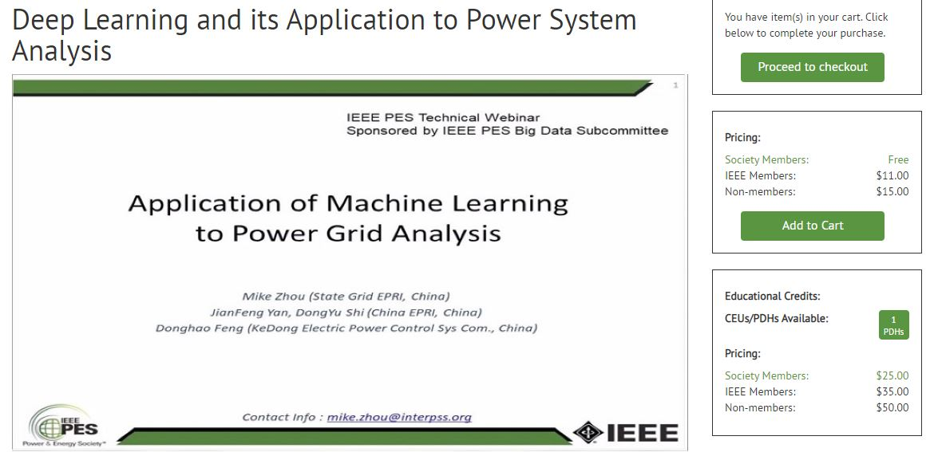
Professional Development & Plain Talk
Issues/“hot topics” that are relevant in the power and energy industry today. Topics are intended for individuals who do not have an engineering background.

Slide 9

Research Paper & Publications
Hear first-hand from authors published in IEEExplore and other industry publications regarding recently published research related to the power and energy industry.

Slide 10
Web based Tutorial
Are geared toward the experienced power engineering professionals and offer in-depth knowledge on a wide array of engineering topics
Are often half-day or full-day conference presentations
Consist of multi-part series, which are presented live, recorded, and archived in the IEEE PES Resource Center
Typically last approximately 80 minutes (60 minutes for the presentation and 20 minutes for Q&A)
Access to Tutorial Library

Slide 11
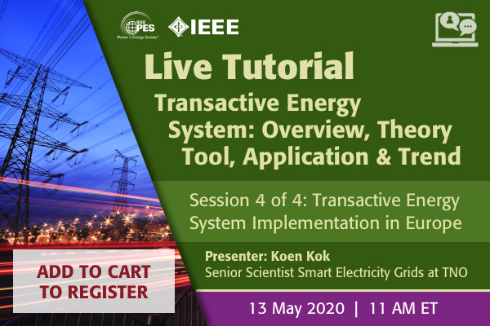

Slide 12
PES Plain Talk
Provide overviews of the power and energy industry's technical aspects for power industry professionals and engineers new to the industry
Offer insight into the demands of regulators, consumer groups, and trends that impact power systems operations
Are presented live in-person taught in a classroom setting by subject matter experts and Online.
Access to PES Plain Talk Library

Slide 13
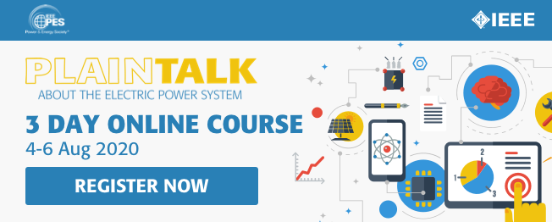

Slide 14
Educational Credits
CEU(Continuing Education Unit) is a currency of sorts that helps to measure a person’s participation in formal education programs.
PDH are Professional Development hours.
Members can earn 0.1CEU/10PDH credits by attending PES Web Tutorials & 0.8 CEU Credits are awarded per session for Plain Talks.

Slide 15

Here’s a good News!

Slide 16
IEEE PES Resource Center
Thousands of peer-reviewed technical resources are available on demand and accessible from anywhere.
Developed by experts in industry and academia, these resources support continuous learning as well as virtual instruction and professional development during the current challenging times.
With Resource Center Members can get access to Conference Videos and Slides, Technical Publications and Educational Materials.

Slide 17
Features of IEEE PES Resonance center
Conference presentations
Technical Publications
On Demand Webinars & Tutorials
Live WebEx Registration
PES Magazine

Slide 18
IEEE Electrification Magazine
IEEE Electrification Magazine is a quarterly magazine dedicated to disseminating information on all matters related to microgrids onboard electric vehicles, ships, trains, planes, and off-grid applications, including electrification of remote communities and decarbonization strategies.

Slide 19
IEEE Power & Energy Magazine
IEEE Power & Energy Magazine is dedicated to disseminating information on all matters of interest to electric power engineers and other professionals involved in the electric power industry
It focuses on advanced concepts, technologies, and practices associated with all aspects of electric power from a technical perspective in energy with nontechnical areas such as business, environmental, and social concerns

Slide 20
PES Notable Presentations
These are some of the best selected Presentations & videos.
The section has mostly all the Presentations and videos from conferences before 2013.
All current Presentation materials are now on Resource Center.

Slide 21
IEEE Open Access Journal of Power and Energy
The IEEE Open Access Journal of Power and Energy is intended to be a technical journal focusing on the development, planning, design, construction, maintenance and many other aspects.
The IEEE Open Access Journal of Power and Energy is a fully electronic, open access publication. It is published by volume only (one volume and single issue a year).

Slide 22
PES Author’s kit
The objective of the Author’s Kit is to provide guidelines for uniform format and style of technical publications to enable efficient reading and reference at a cost that permits publication of all papers accepted by the IEEE Power & Energy Society.
This Author’s Kit is a reference document.

Slide 23
IEEE Collabratec
It is a networking platform exclusively for IEEE members around the globe to connect, network, share and innovate technology.
Connect with any IEEE member/volunteer around the globe
Create relevant groups with people
Find out job opportunities
Search for local events/conferences

Slide 24
IEEE PES India Scholarship Award(IPISA)
This award has been established to encourage young people entering the Electrical engineering and technology profession.
The amount of scholarship will be Rs. 75,000/- (Rs. Seventy five thousand only) per student per year to be renewed annually for entire duration of degree course subject to further qualifying requirements.
For more details visit:https://www.ee-scholarship.org/about-the-scholarship/india

